Slide 1





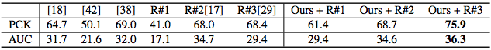
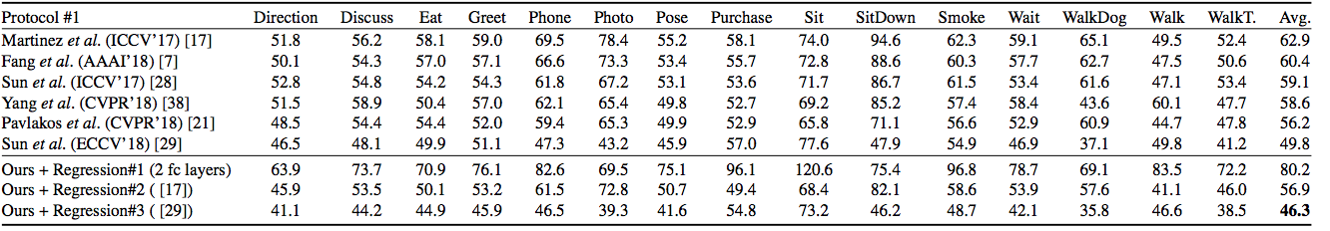
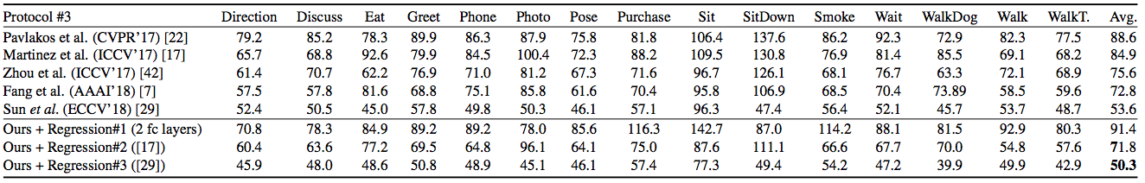
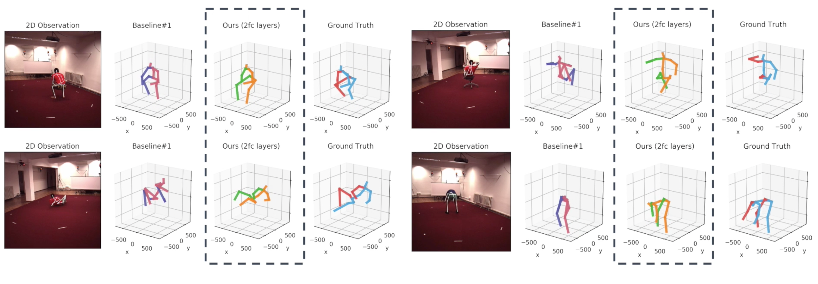
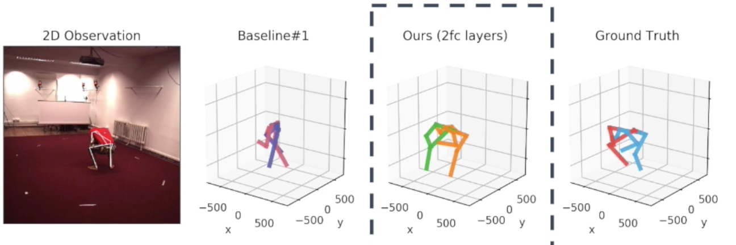
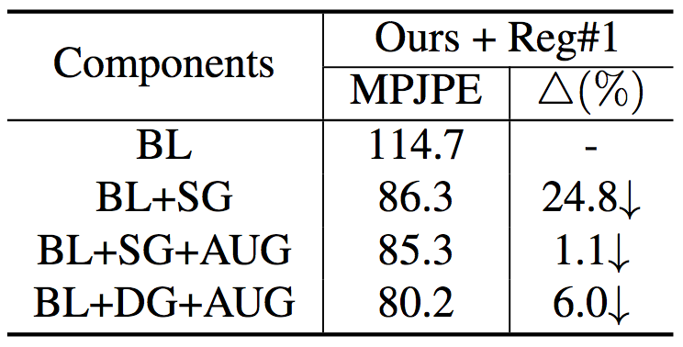
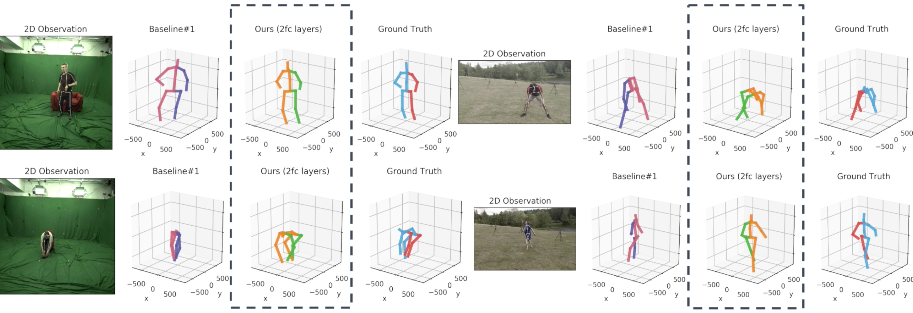
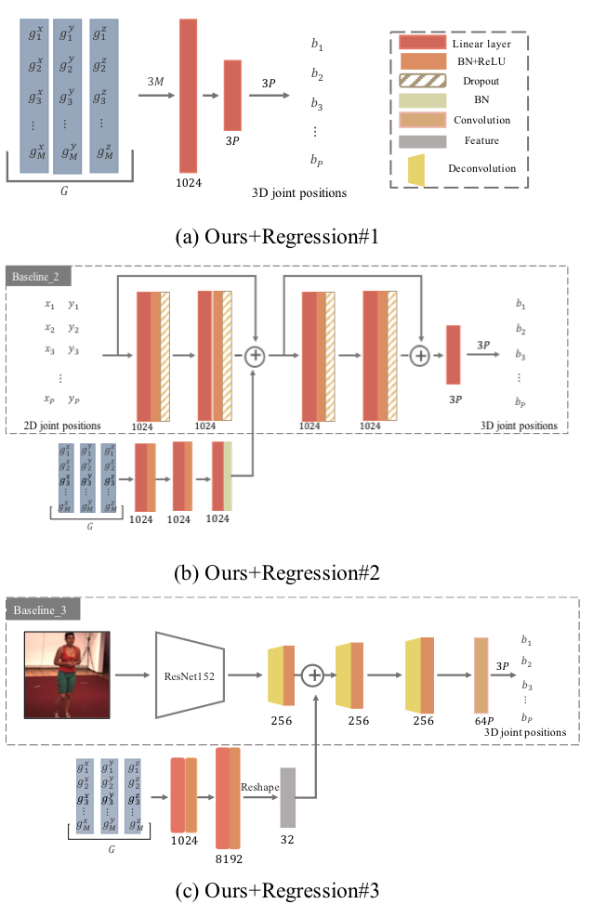




Weakly-Supervised Discovery of Geometry-Aware Representation for 3D Human Pose Estimation
Xipeng Chen*¹, Kwan-Yee Lin*^{2,3}, Wentao Liu³, ChenQian³, Liang Lin¹
¹Sun Yat-Sen University ²Peking University ³SenseTime Research
1. Introduction
2. Methodology
4. Quantitative Results
Target OF our work
To devise a simple yet effective framework that learns a 3D geometry represen-tation of human pose with only accessible 2D annotation as supervision.
Table 1: Cross-dataset comparison on the MPI-INF-3DHP dataset.
motivation
Multi-view data provides 3d geometry information but usually relies on auxiliary 2.5D annotations or a large quantity of 3D training samples.
Figure 1: Ablation studies. The evaluation is performed on Human3.6M with R#3 as baseline.
Figure 2: Evaluation of using different number of training data.
Leverage the latent code of a novel view synthesis framework but not all factors in the latent code are necessary.
Latent representation disentanglement and semantic constraint.
contributions
We propose a different approach to learn the geometry representation for the human pose under multi-view setting with view synthesis.
A skeleton-based view synthesis is proposed to solve the latent space disentanglement problem.
A representation consistency loss is introduced to constrain the learning
process of latent space.
Total loss
Representation consistency loss
$$ℒ=L_{l_{2}}\left(φ∙φ,θ\right)+L_{l_{2}}\left(μ∙ν,ζ\right)+L_{rc}\left(φ,μ,θ\right)$$
$$l_{rc}=\sum_{m=1}^{M}{{\left\|g_{{ij}_{m}}−g_{j_{m}}\right\|}_{2}^{2}}$$
Reconstruction loss
Table 2: Quantitative comparisons of Mean Per Joint Position Error (mm) between the estimated pose and the ground-truth on Human3.6M under Protocol #1, #3.
3. Application: 3D Human Pose Estimation
5. Point Cloud Interpolation
WAy1: as an intermediate representation
$$×$$
WAy2: As a 3D geometry prior
$$√$$
Ours + Martinez et al. (ICCV’17)
Ours + Sun et al. (ECCV’18)

